Slide 1

Institution's Innovation Council Management System
Batch – 8
Y Jayanthi
21331A05I8
K Hemanth Kumar 21331A0597
K Akash
21331A0571
G Nikhil
21331A0353
Project Supervisor
M.Vamsi Krishna
Senior Assistant Professor

Slide 2

1 | Project Overview
2 | Current Progress & Features
3 | Implementation
4 | Key Features Implementation
AGENDA

Slide 3

The IIC Management Platform is designed to automate innovation-related operations at MVGR College.
Key Objectives
Automate IIC operations and reduce manual workload.
Centralized platform for students, faculty, and admins.
Efficient documentation and project management.
Enhance collaboration and innovation tracking.
Core Features:
Role-based login (Students, Faculty, Admins)
Project & Report Management
Event & Initiative Tracking
Dashboard & Analytics
Project Overview

Slide 4
Progress So Far
User Authentication System (Login for Students, Faculty & Admins)
Admin Dashboard for managing projects, students, and reports
Project & Report Submission Module Event & Initiative Tracking (SIH, SynergyX, Startups)
Basic UI & Navigation Completed
Features Implemented
Login & Role-Based Access – Secure authentication for different users.
Project Management – Submission, review, and approval system.
Report Generation & Viewing – Automated document handling.
Admin Controls – Manage users, batches, and activities.
Current Progress & Features

Slide 5
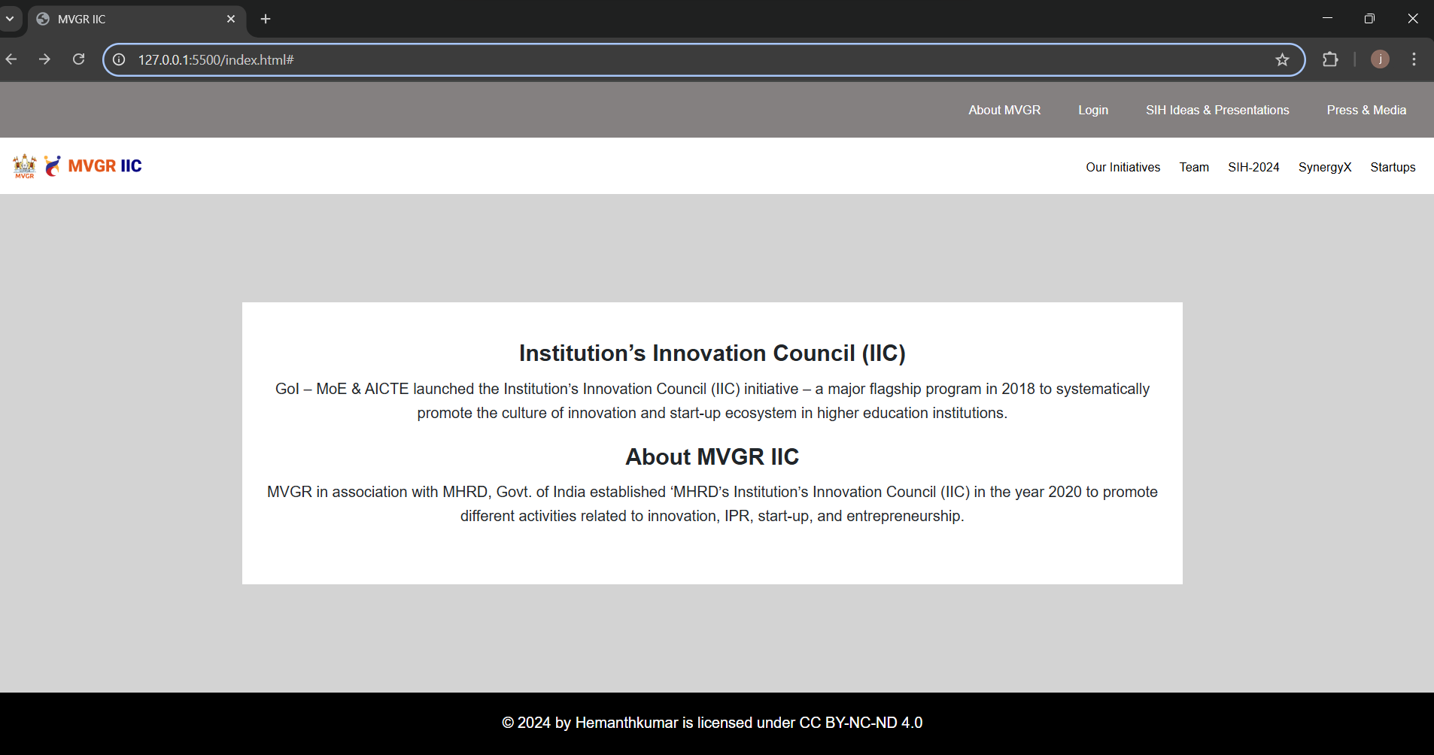
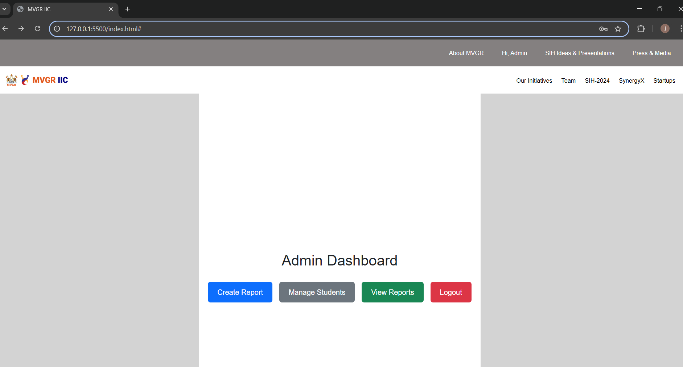
Implementation
1.1)This is the homepage of the IIC Management Platform, providing an overview of IIC and MVGR IIC. Users can navigate to Login, SIH-2024, SynergyX, Startups, and other initiatives from here.
1.2)The Admin Dashboard of the IIC Management Platform provides a streamlined interface for managing innovation-related activities. It allows admins to create reports, manage students, and view reports efficiently. The dashboard ensures easy navigation with dedicated buttons for each function, along with a logout option for security.

Slide 6
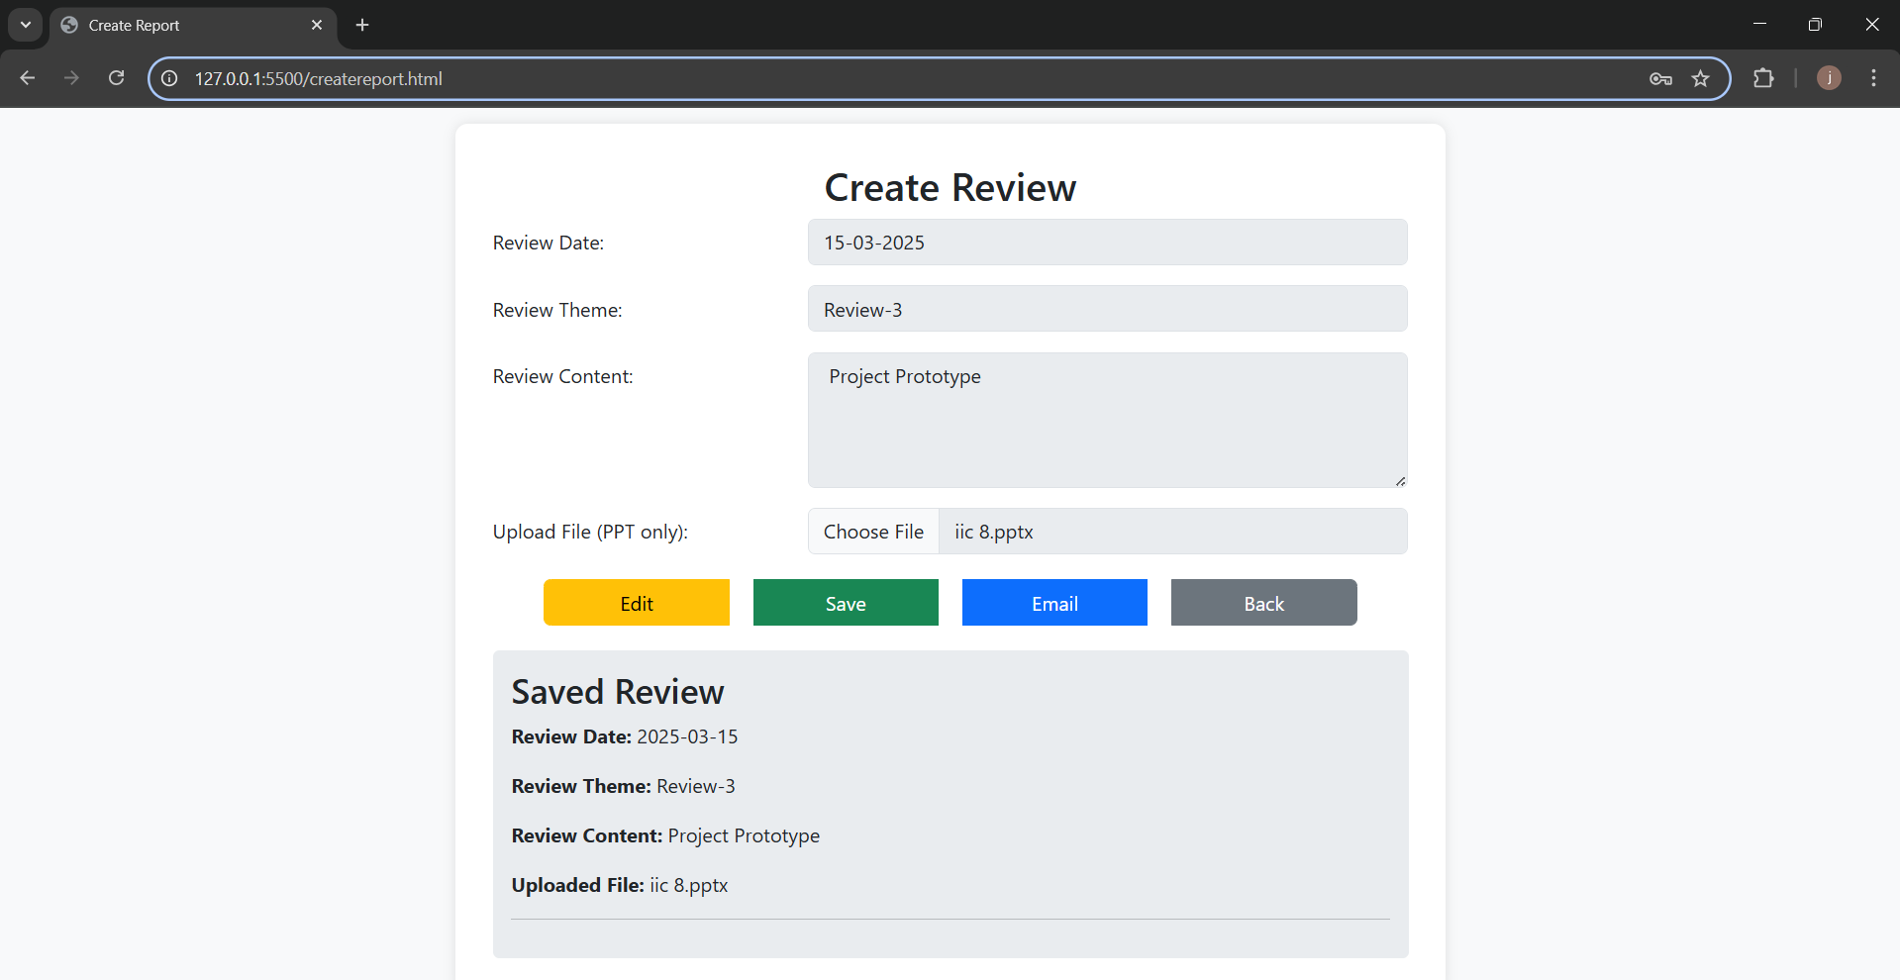
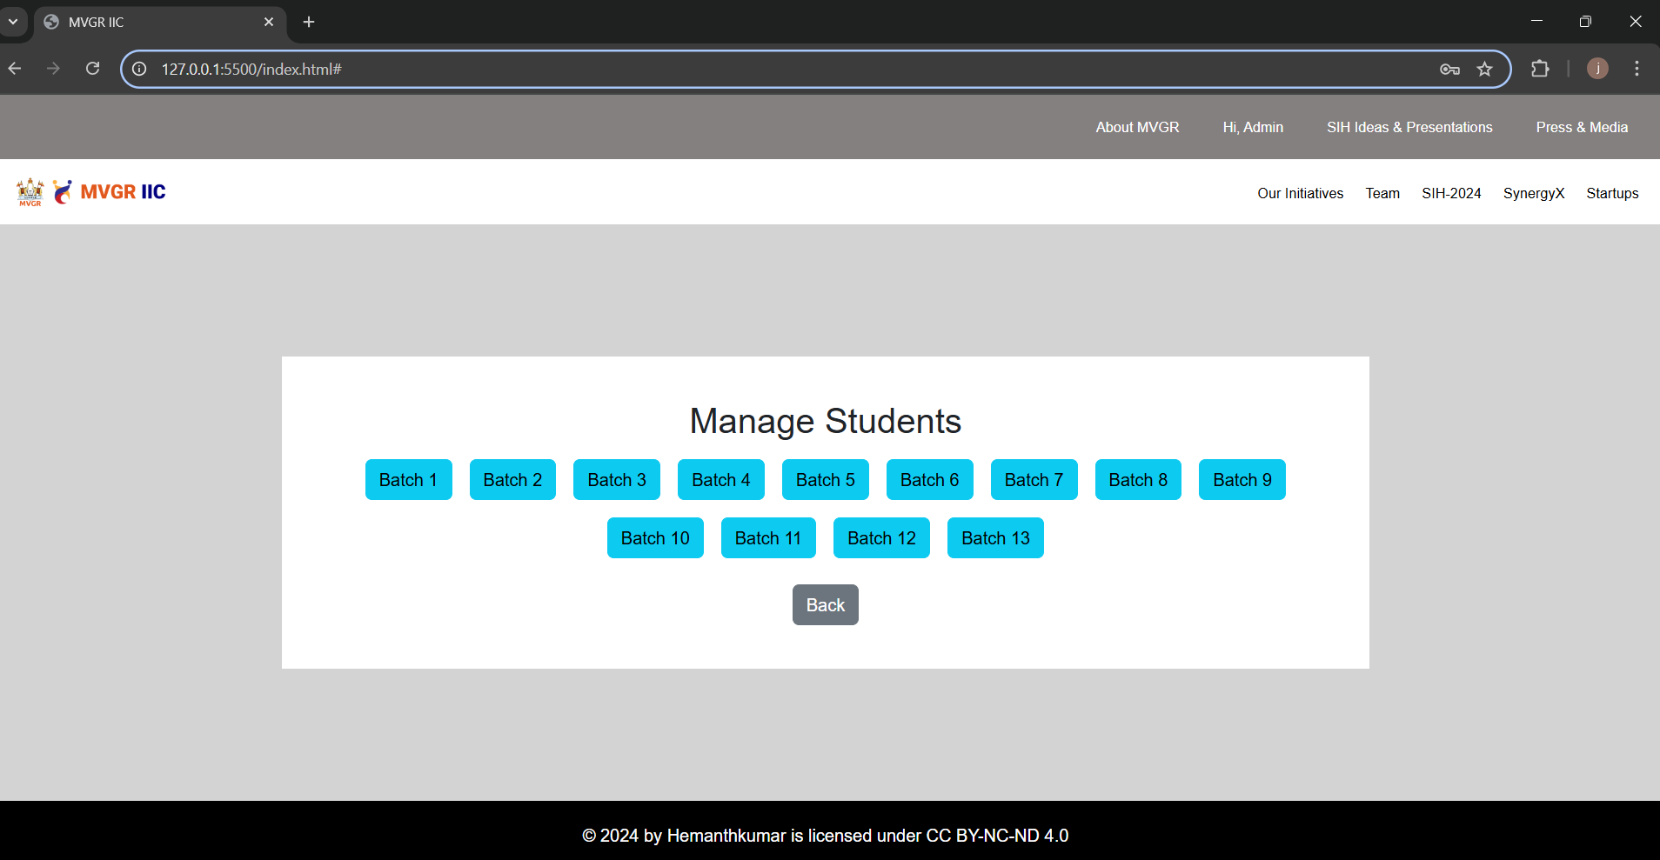
Key Features Implementation
2.1) The Create Review page allows users to input a review date, theme, content, and upload a PPT file. It provides options to edit, save, email, or go back, ensuring efficient review management. A saved review section displays previously entered details.
2.2) A feature within a student management system that allows users to view batch details, such as student groups, progress tracking, or administrative records.

Slide 7
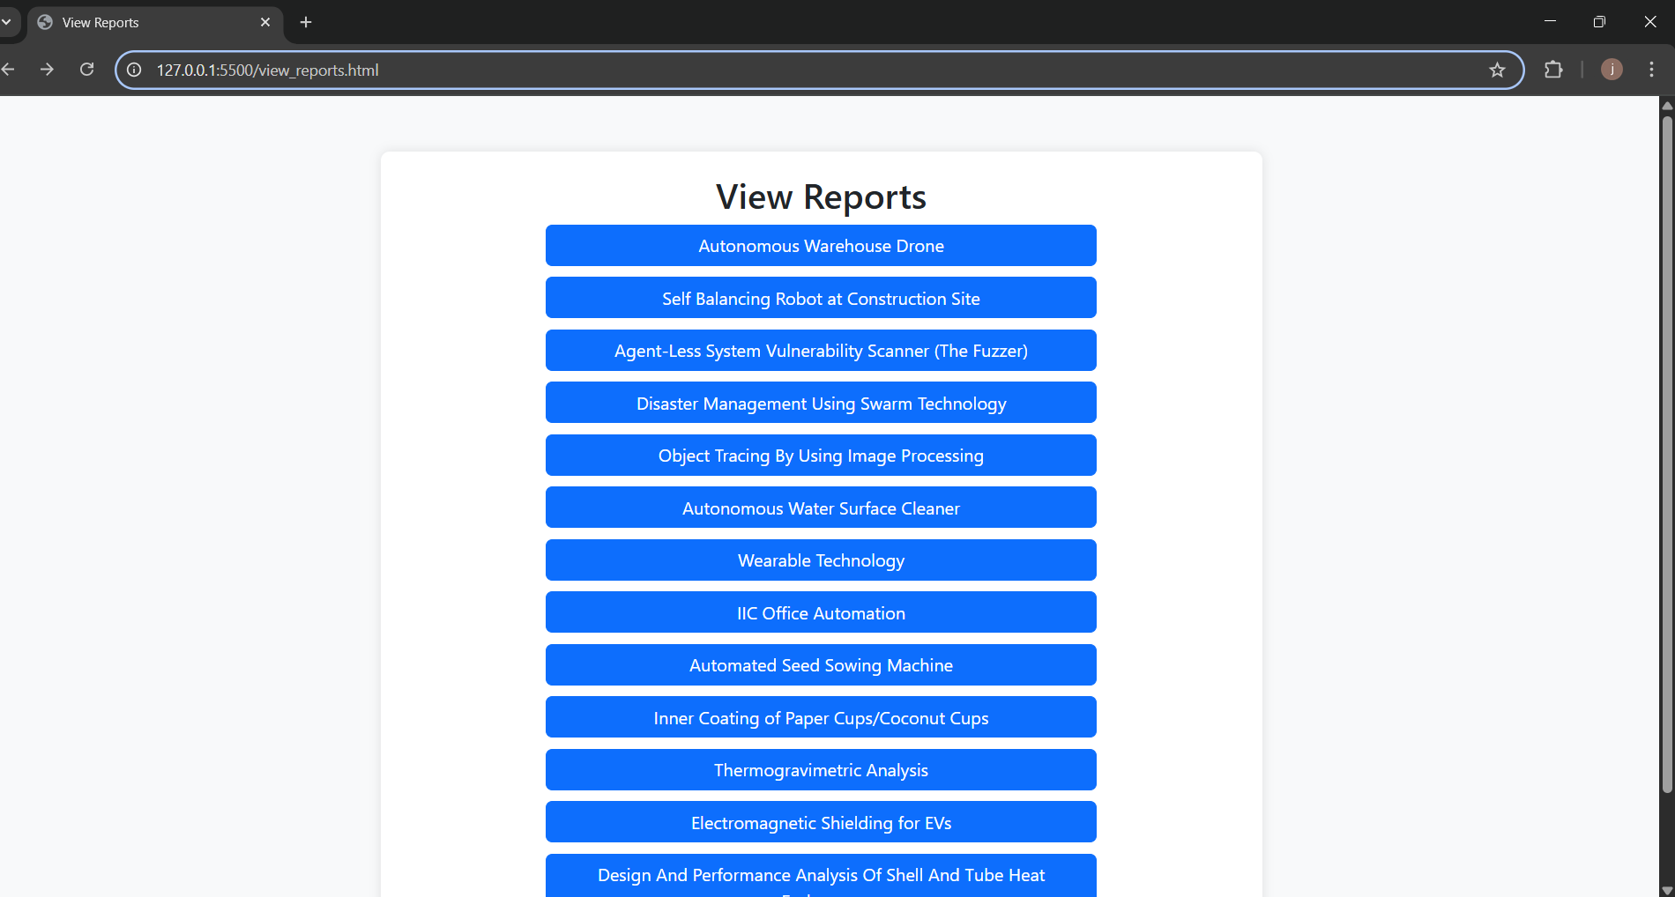
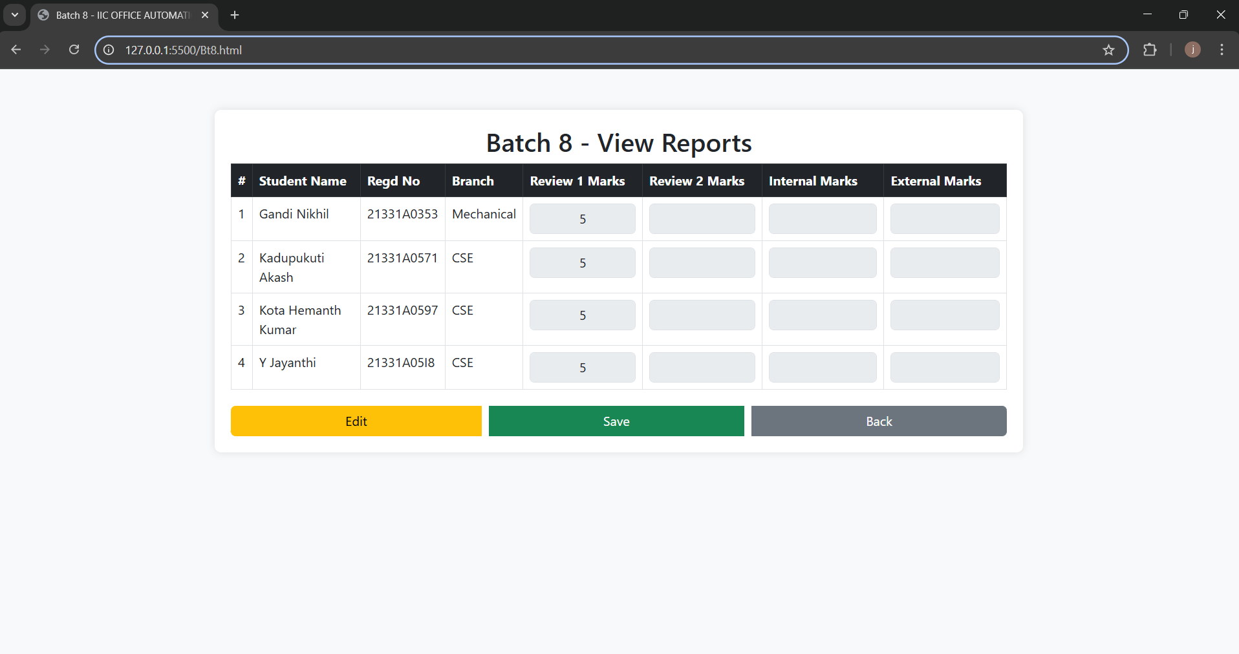
Key Features Implementation
2.3)To view all batches individually and post their marks, provide clickable buttons for each batch. Each button will navigate to a page where student marks can be entered and updated.
2.4) To post student review marks and update them.

Slide 8


Thank You!

